Slide 1
Project Presentation Insight Scan
Presented by – Shruti Asolkar
Date – 12/5/2024

Slide 2
Introduction
What does the project achieve? - Automated Collection and Classification of User Comments
Objective:
Automate the collection and classification of user feedback from Google Play Store, and Apple App Store to help developers prioritize issues.
Key Goals:
Extract user comments efficiently.
Summarize key themes from feedback.
Identify and prioritize negative feedback.

Slide 3
Motivation
Why this project?:
Manual review of user comments is time-consuming for developers managing apps with large user bases.
Feedback holds critical insights for improving user satisfaction and fixing bugs.
Impact: Automating this process saves time, provides actionable insights, and enhances app quality.

Slide 4
Problem Statement
Challenge:
Developers struggle to extract relevant insights from large volumes of feedback across multiple platforms.
Proposed Solution: Build an automated system for:
Collecting user comments.
Summarizing themes using NLP.
Classifying sentiment (with a focus on identifying negative comments).

Slide 5
Techniques
Web Scraping:
Google Play: Used ‘requests’ and ‘BeautifulSoup’ to extract reviews.
Apple App Store: Used ‘AppStoreScraper’ API to fetch reviews.
Natural Language Processing:
Summarization: Preprocess reviews by removing stopwords, punctuations, and applying tokenization.
Sentiment Classification: Assign sentiment (positive, neutral, negative) based on ratings.
Machine Learning:
Classifier: Trained a Naive Bayes classifier with TF-IDF feature extraction.
Notes:
Naive Bayes classifier with TF-IDF feature extraction for sentiment analysis. Naive Bayes is a simple yet powerful algorithm that predicts categories like positive, neutral, or negative by assuming each word in a review contributes independently to its sentiment. TF-IDF, which stands for Term Frequency-Inverse Document Frequency, converts words into meaningful numerical values

Slide 6
Implementation
Scraping:
Scripts developed for Google Play and Apple App Store to collect reviews and store them in CSV files.
Data Processing:
Cleaned and tokenized reviews.
Merged data for consistency across platforms.
Training and Testing:
Split reviews into 80% training and 20% testing sets.
Evaluated using accuracy score and classification report.
Output:
Generated a CSV file with sentiment labels for each review.

Slide 7
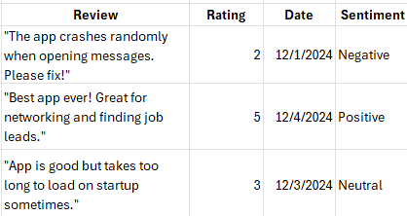
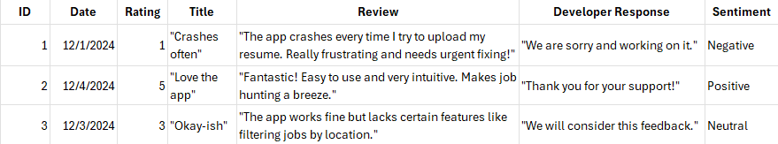
Evaluation
Metrics for Success:
Sentiment Analysis: Successfully labeled comments as positive, neutral, or negative.
Enables developers to quickly identify critical feedback and respond effectively.
Classifier Accuracy
Future Work:
Expand to GitHub issues.
Experiment with advanced classification models

Slide 8
Question + Answers
I’d be happy to answer any questions you have now.

